Slide 1
PROVISO
30 mins (5mins on each topic). Not much time to share – but I’ll share what I think is CORE.
You can look up (Google) the EASY stuff yourself. My job is to give you what you can’t find easily online.
At some points during the next 30 mins Enemy is going to try to tell you that this is too complex to understand. He is a LIAR. I’m going to give you high-level Psych. But I will explain it in a way that is digestible and applicable. Allow HS to help. Ready?

Slide 2

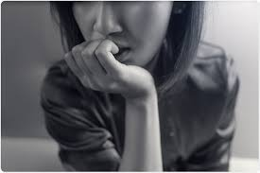


K I N G S ‘ I N S T I T U T E
MENTAL HEALTH 2020
D R. N E A L

Slide 3
K I N G S ‘ I N S T I T U T E
MENTAL HEALTH 2020
D R. N E A L

Slide 4
THE IMPACT OF 2020
ANXIETY SELF-DIAGNOSIS
“I WANT MY OLD LIFE BACK”
THE REWIRING WORD OF GOD

Slide 5
THE IMPACT OF 2020

Slide 6
STATS
JUNE 2020
THE IMPACT OF 2020
40% ADVERSE MH REACTION
25% 0F 18-24 YR OLDS SERIOUSLY CONSIDERED SUICIDE IN LAST 30 DAYS
DOUBLE THAT OF THE PREVIOUS YEAR!

Slide 7
ELEVATED PREVALANCE DISPROPORTIONATELY AFFECTING YOUNG ADULTS
THE IMPACT OF 2020

Slide 8
INCREASED SUICIDAL IDEATION;
PREDICT 75,000 “DEATHS OF DESPAIR”
THE IMPACT OF 2020

Slide 9

ASSOCIATIVE LEARNING
CONDITIONING
THE IMPACT OF 2020
RESTRICTED FREEDOM/CONTROL OF MOVEMENT IS A FORM OF PUNISHMENT
    GROUNDED
    DETENTION
    PRISON
CURRENT EXPERIENCE ASSOCIATED WITH PUNISHMENT
(EXPLAINING OTHERWISE WILL NOT BREAK THE ASSOCIATION)
    THINK DOG WITH LEASH

Slide 10
UNWANTED SIDE EFFECTS OF
PERCEIVED PUNISHMENT
THE IMPACT OF 2020
CURRENT SITUATION TRIGGERS BASIC PSYCHOLOGICAL MECHANISMS
PASSIVE-AGGRESSION
BEHAVIOURAL SUPPRESSION
RESENTMENT
DISPLACED AGGRESSION
LEARNED HELPLESSNESS…

Slide 11
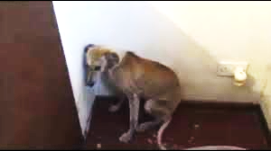
LEARNED
HELPLESSNESS
(MARTIN SELIGMAN)
THE IMPACT OF 2020

Slide 12

“KEEP 6FT AWAY”
AETIOLOGICAL FACTORS
THE IMPACT OF 2020
SOCIAL ISOLATION (DESPITE BEING DIGITAL-NATIVES)
IDENTITY FRACTURE
SOCIO-EMOTIONAL - ADOLSECENTS CRAVE INDEPENDENCE/AUTONOMY
LOSS OF STRUCTURE
BREAK IN CONTINUITY
FUTURE UNCERTAINTY
MISSED SIGNIFICANT LIFE EVENTS
  TRADITIONAL HALLMARKS, FUNERALS, BIRTHDAYS, PROM, BIRTHS
ADDITIONAL FAMILY STRESS
FEAR OF ILLNESS/EXPOSURE
LOSS OF SECURITY; UNSAFE
COMPLICATES ALL RELATIONSHIPS
ADDITIONAL RESPONISIBILITIES AT HOME
ZOOM FATIGUE
ANGER + GRIEF RESPONSE REGARDING LOSS OF TIME/EXPERIENCES
COMPOUNDING NORMAL DEVELOPMENTAL-STRESSES

Slide 13
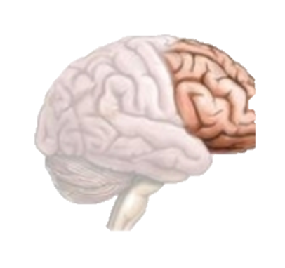
ADOLESCENT BRAIN
THE IMPACT OF 2020
PFC NOT FULLY DEVELOPED ‘TIL 25
  LIMITING IMPULSE CONTROL, CRITICAL THINKING, EMOTIONAL REGULATION
REGULAR HORMONAL CHANGES→
  HEIGHTENED SENTITIVITY TO STRESS
=
WORLD UPSIDE DOWN→ DYSREGULATION

Slide 14
LONG-TERM EFFECTS
THE IMPACT OF 2020
EX. 911
SURVEYED VALUES OF TEENAGERS DRAMTATICALLY SHIFTED FOLLOWING 911 → SAFETY AND SECURITY
FOLLOWING PANDEMIC→ ???? FREEDOM? IN PERSON? STABILITY?

Slide 15
SPIRITUAL HEALTH =
THE IMPACT OF 2020
OUR SPIRITUAL HEALTH IS A DIRECT FUNCTION OF OUR RELATIONSHIP WITH JESUS CHRIST

Slide 16
SPIRITUAL HEALTH =
THE IMPACT OF 2020
MEDIATORS
ROUTINES
PATTERNS/RHYTHMS
OUR SPIRITUAL HEALTH IS A DIRECT FUNCTION OF OUR RELATIONSHIP WITH JESUS CHRIST
CONTACT WITH ROLE MODELS/REMINDERS
ANGER/DISTRUST

Slide 17
THE IMPACT OF 2020
ANXIETY SELF-DIAGNOSIS
“I WANT MY OLD LIFE BACK”
THE REWIRING WORD OF GOD

Slide 18
ANXIETY SELF-DIAGNOSIS
"how to handle students who thrive on the label of 'having anxiety"

Slide 19
ANXIETY SELF-DIAGNOSIS
WHAT IS AT CORE?
EX. IT’S NEVER ABOUT THE TRASH

Slide 20
ANXIETY SELF-DIAGNOSIS
ATTENTION?
LENIENCY?
VALIDITY?
SPACE?
WHAT IS THE BENEFIT?

Slide 21
ANXIETY SELF-DIAGNOSIS
HIGH % ARE ACTUALLY SUFFERING FROM ANXIETY
EPIDEMIC
SOCIAL-MEDIA
FEWER BUFFERS
ANXIETY ON A SPECTRUM
REMEMBER…

Slide 22
SPECTRUM
ANXIETY SELF-DIAGNOSIS
MILD –> SUBCLINICAL -> CLINICAL
MAY NOT BE A DISORDER, BUT STRESS!

Slide 23
STRESS =
ANXIETY SELF-DIAGNOSIS
BODY’S NON-SPECIFIC RESPONSE TO PERCEIVED THREAT

Slide 24
STRESS =
ANXIETY SELF-DIAGNOSIS
BODY’S NON-SPECIFIC RESPONSE TO PERCEIVED THREAT

Slide 25
CORTISOL
STRESS RESPONSE
ANXIETY SELF-DIAGNOSIS
UNDER 18s PERCEIVED THREATS

Slide 26
FACILITATE COPING
ANXIETY SELF-DIAGNOSIS
CAN’T ELIMINATE STRESS BUT CAN MANAGE IT
‘WHAT IS ANXIETY’
HEALTHY RESPONSES TO STRESS
WHERE TO PLACE ATTENTION
THE NATURE OF FEAR (WHO/WHAT WE BELIEVE)

Slide 27
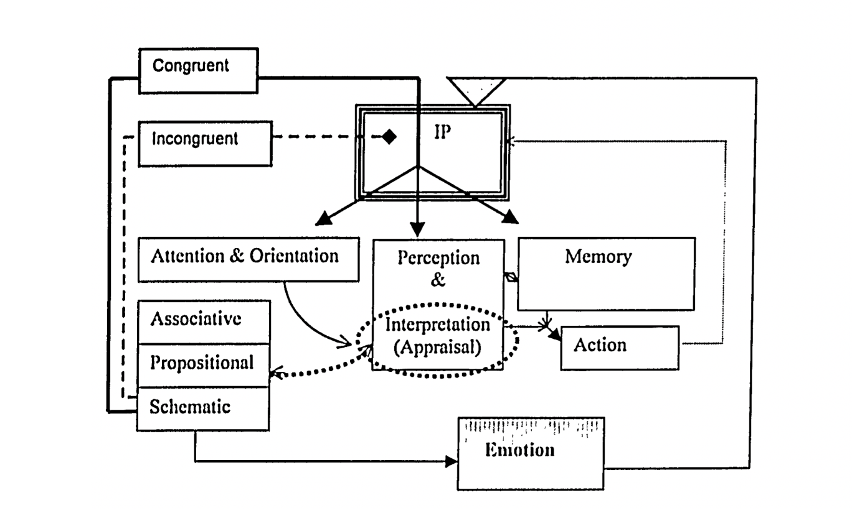
NEURO-COGNITIVE INFORMATION PROCESSING MODEL (L NEAL 2002)

Slide 28
NEURO-COGNITIVE INFORMATION PROCESSING MODEL (L NEAL 2002)

Slide 29
THE IMPACT OF 2020
ANXIETY SELF-DIAGNOSIS
“I WANT MY OLD LIFE BACK”
THE REWIRING WORD OF GOD

Slide 30
“I WANT MY OLD LIFE BACK”

Slide 31
“I WANT MY OLD LIFE BACK”
WHAT IS STABLE
MARKER OF SUCCESS
CONTEXTUALIZE
REFRAME
OTHER CULTURES
CONTROL
HEALTHY ROLE MODELS
ADAPTABILITY

Slide 32
“I WANT MY OLD LIFE BACK”
WHAT IS STABLE IN LIFE IS JESUS, EVERYTHING ELSE TEMPORARY.
MARKER OF SUCCESS = ABILITY TO BE FLEXIBLE AND ADAPT TO CHANGE
THE ONLY THING CERTAIN IS UNCERTAINTY
DO NOT FEAR CHANGE. EMBRACE IT.
CONTEXTUALIZE CHANGE - WITH NORMAL DEVELOPMENTAL CHANGE (EX CAN’T GO BACK TO PLAYING WITH DOLLS OR WEARING DIAPERS)
REFRAME CHANGE - CHANGE IS GOOD.
OTHER CULTURES VIEW IT AS OPPORTUNITY TO GROW/LEARN.
THE NATURE OF CONTROL (WHAT WE CAN AND CANNOT CONTROL) – OUR SELVES.
NELSON MANDELA IN PRISON – JOGGED ON THE SPOT.
ADAPTABILITY
(DETAILS)

Slide 33

“I WANT MY OLD LIFE BACK”
RESILIENCE
“A measure of the persistence of a system and the ability to absorb change and disturbance and maintain healthy state; the capacity to recover quickly from difficulties; mental toughness”

Slide 34
“I WANT MY OLD LIFE BACK”
RESILIENCE: FAMILY VALUE
“A measure of the persistence of a system and the ability to absorb change and disturbance and maintain healthy state; the capacity to recover quickly from difficulties; mental toughness”

Slide 35
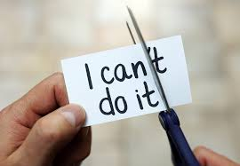
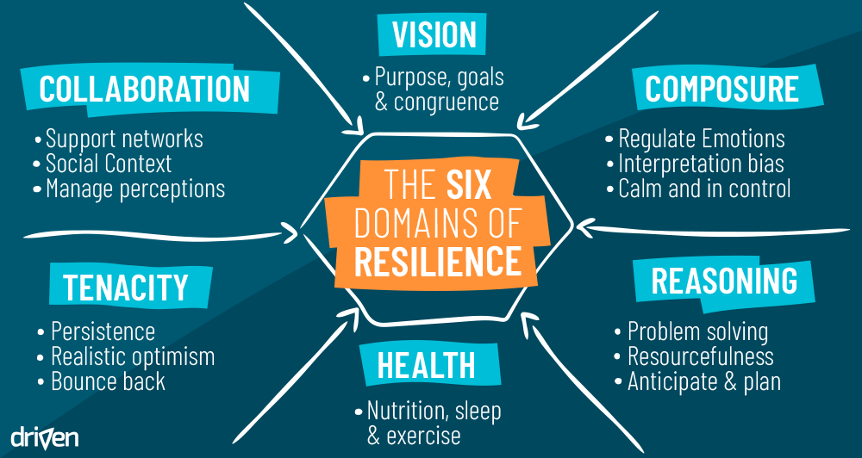
“I WANT MY OLD LIFE BACK”
FOSTERING RESILIENCE

Slide 36
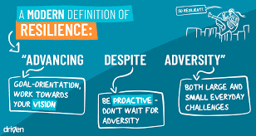
“I WANT MY OLD LIFE BACK”
FOSTERING RESILIENCE

Slide 37
THE IMPACT OF 2020
ANXIETY SELF-DIAGNOSIS
“I WANT MY OLD LIFE BACK”
THE REWIRING WORD OF GOD

Slide 38
THE REWIRING WORD OF GOD

Slide 39

THE REWIRING WORD OF GOD
THE WORD OF GOD
ALIVE AND POWERFUL; TRUTH
RESTRUCTURES + REPROGRAMS BRAIN
WORD NOT JUST TEACHING ABOUT THE WORD

Slide 40
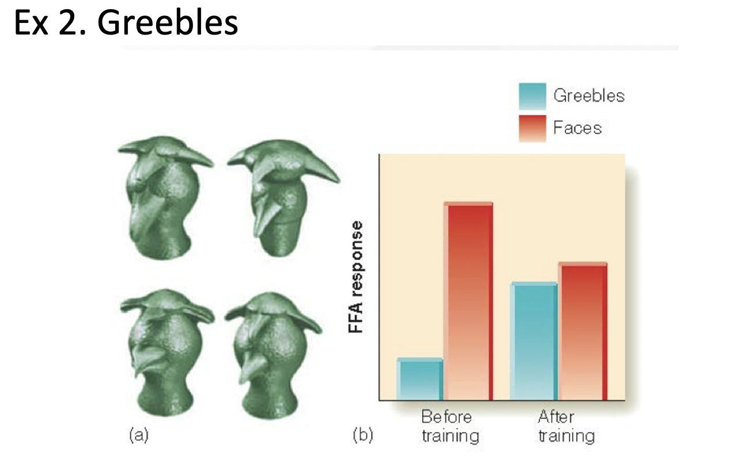
SYNAPTIC CONSOLIDATION AND SCHEMATIC PROCESSING
THE REWIRING WORD OF GOD
WHAT THE BRAIN BELIEVES/EXPECTS COMES FROM WHAT WE PLACE IN IT. NEURONS ADAPT AND BECOME TUNED/SPECIALIZED TOWARDS REPEATED STIMULI

Slide 41
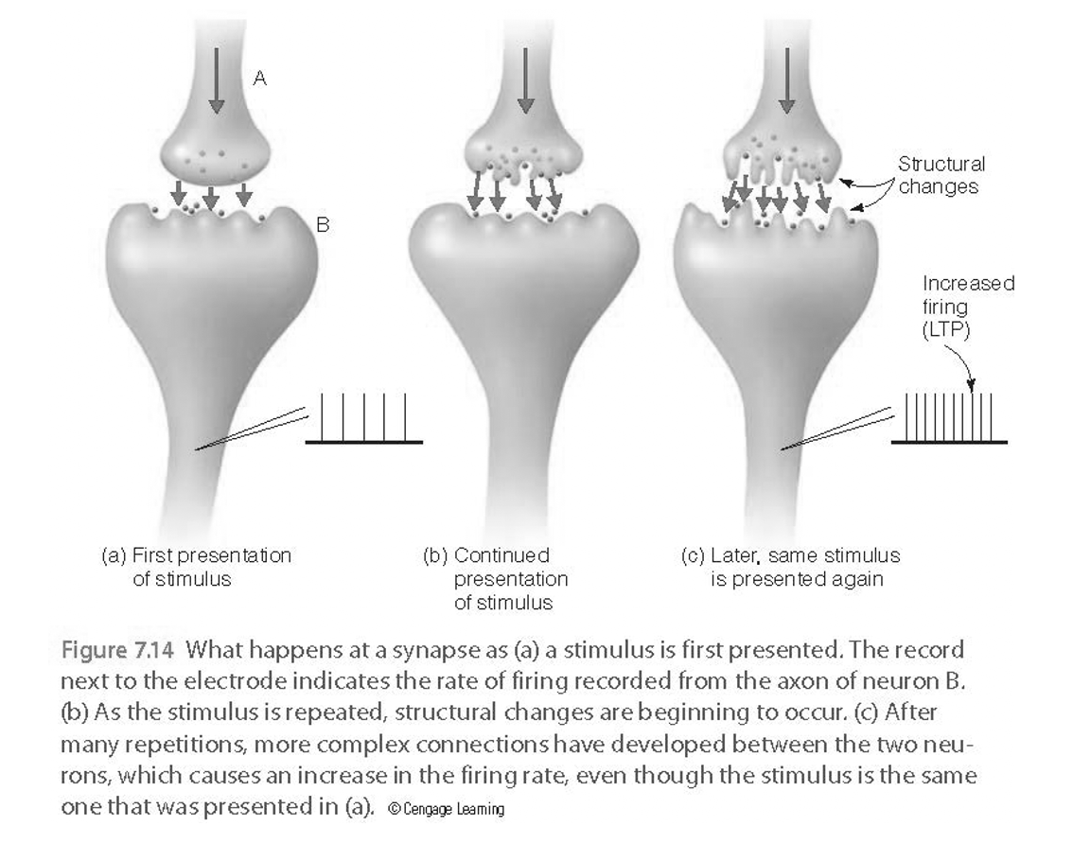
SYNAPTIC CONSOLIDATION AND SCHEMATIC PROCESSING
THE REWIRING WORD OF GOD
REPEATED EXPOSURE MATTERS!

Slide 42
SYNAPTIC CONSOLIDATION AND SCHEMATIC PROCESSING
THE REWIRING WORD OF GOD
WORLD | WORD
REPEATED EXPOSURE MATTERS - THIS IS TRUE FOR THINGS OF WORLD OR THINGS OF GOD.
A PERSON’S BRAIN WILL BECOME SPECIALIZED BASED ON ONE OR ANOTHER = COMPETING STIMULI

Slide 43
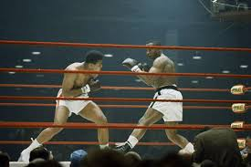
ALI V LISTON
THE REWIRING WORD OF GOD
WORD OF GOD
WORLD

Slide 44
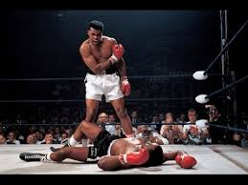
THE REWIRING WORD OF GOD

Slide 45
THE REWIRING EFFECT OF THE WORD OF GOD
Do not conform to the pattern of this world but be transformed by the renewing of your mind.
ROMANS 12.2

Slide 46
SCHEMATIC PROCESSING
THE REWIRING WORD OF GOD
BRAIN WILL INTERPRET, ACT, EMOTE, BASED ON NEURONAL EXPECTANCIES/SCHEMA
IS OUR BRAIN CONGRUENT WITH WORD?

Slide 47
SCHEMATIC PROCESSING
THE REWIRING WORD OF GOD
BRAIN WILL INTERPRET, ACT, EMOTE, BASED ON NEURONAL EXPECTANCIES/SCHEMA
IS OUR BRAIN CONGRUENT WITH WORD?
WHAT WE BELIEVE INFLUENCES WHAT WE PERCEIVE

Slide 48
SCHEMATIC PROCESSING
THE REWIRING WORD OF GOD
BRAIN WILL INTERPRET, ACT, EMOTE, BASED ON NEURONAL EXPECTANCIES/SCHEMA
IS OUR BRAIN CONGRUENT WITH WORD?
WHAT WE BELIEVE INFLUENCES WHAT WE PERCEIVE
WHAT WE PERCEIVE INFLUENCES WHAT WE DO AND FEEL

Slide 49

7 SIMPLE IDEAS FOR PARENTS/LEADERS
THE REWIRING WORD OF GOD
GATEKEEPERS NEEDED TO RECOGNIZE WARNING SIGNS
  TO RECOGNIZE WARNING SIGNS
ROLE MODEL HEALTHY COPING
TEACH SELF/SOUL CARE AND RESILENCE
FOSTER EMOTIONAL DEVELOPMENT BY TALKING
ENGAGE THEM IN ROUTINES/ SCHEDULING
FACILITATE ACCESS TO PROFESSIONAL HELP
PROVIDE RESOURCES
WWW.ADOLESCENTHEALTH.ORG/COVID-19/COVID-19-RESOURCES-FOR-PARENTS-AND-TEENS.ASPX

Slide 50
W W W . K I N G S . I N S T I T U T E
SHARING KNOWLEDGE WITH THE BODY OF CHRIST FOR THE FURTHERMENT OF THE KINGDOM

